Slide 1
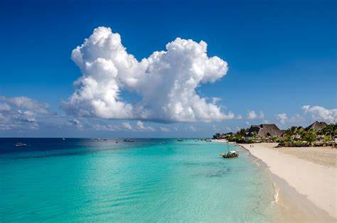
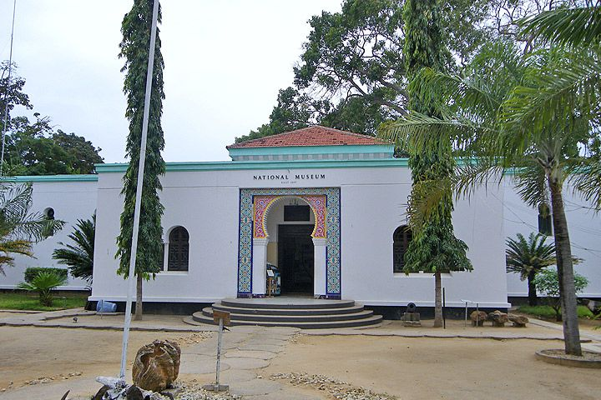
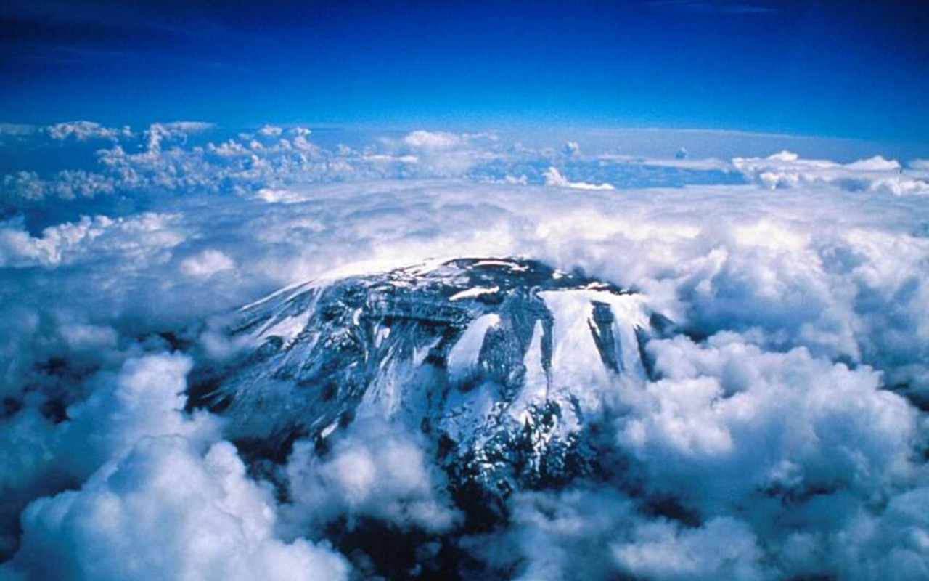
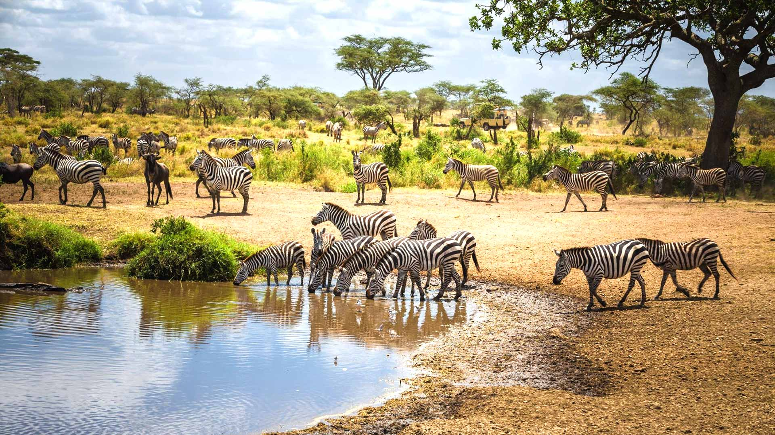

Slide 5
TOURISM

Slide 6
TOURISM

Slide 7
TOURISM

Slide 8
TOURISM

Slide 9
TOURISM

Slide 10

TOURISM;
Here in our Tanzania, we have great tourist attractions.
For example:
We have beautiful beaches like Nungwi beach, Coco beach, Paje beach, Zanzibar etc.
The highest mountain MOUNT KILIMANJARO and others like mount. Meru.
We have spectacular lakes, rivers and ocean like lake Victoria, lake Tanganyika, Indian ocean etc.
We have best food.
We have historical sites like Ismila, Amboni caves, prison island etc.
We have pretty wildlife places like Ngorongoro crater, Serengeti national park, Mikumi national park, Manyara national park etc.

Slide 11
TOURISM;
Here in our Tanzania, we have great tourist attractions.
For example:
We have beautiful beaches like Nungwi beach, Coco beach, Paje beach, Zanzibar etc.
The highest mountain MOUNT KILIMANJARO and others like mount. Meru.
We have spectacular lakes, rivers and ocean like lake Victoria, lake Tanganyika, Indian ocean etc.
We have best food.
We have historical sites like Ismila, Amboni caves, prison island etc.
We have pretty wildlife places like Ngorongoro crater, Serengeti national park, Mikumi national park, Manyara national park etc.
We have various cultures and tribes to learn about and from like Masaai, Chaga, Sukuma etc.

Slide 12
TOURISM
We have all of this great places mentioned in the previous slide but not a lot of people know about it.
Tanzania barely receives any tourists because most of the people have not even heard the name of our country Tanzania.

Slide 13
TOURISM
So we have made a project to solve this problem.
We have made a prototype website that shows the tourist attraction in Tanzania.
This website shows all the things, places and activities a tourist can do when they visit Tanzania.

Slide 14
TOURISM
When travellers use this site to learn about and plan trips to Tanzania, they'll gain an even deeper appreciation for what makes this nation truly special. And when they share their experiences back home, it will inspire more people to visit.
In that way, with improved online promotion and resources, I believe this website can significantly boost tourism numbers and revenues. That means more jobs and opportunities for economic development across Tanzania. I'm proud of the role all of us played in launching this site and know its positive impact will be felt for many years
TOURISM

Slide 15
TOURISM
Now we’ll show our website!!
GROUP MEMBERS:
Ayman Feroz.
Suleiman Hamid.
Salim Mohammed.
Othman Abdallah.
Habiba Hatim.
THANK YOU!

